Slide 1


Austin Airbnb Market
Analysis- Team 3
Dharkar Gauri
Dodamani Vishal
Jethwa Shlok
Joshi Jay
Parekh Malav
Shah Ami

Slide 2
Contents
Data Processing & Model used for Kaggle
Why Austin Market
Exploratory Analysis
Business Case 1- Initial Acquisition
Business Case 2 - Pricing and Management
Business Case 3 - Upgrades and Renovations
Summary for Business Cases
Conclusion

Slide 3
Data Processing & Model used for Kaggle Competition
Data Processing Steps - Cleaning the data and creating dummy variables, data transformation i.e. creating factors and levels out of normal data, and then we did attribute selection and removed some of the attributes.
Final method used - XGBoost and the parameters were set to their default values. Except for one i.e. for eval_metric we used AUC.
Variables in Final Model - The variables such as host_about, house_rules, etc which were of less significance were removed.
Performance(AUC) achieved - 0.803

Slide 4
Why Austin Market?
Cheaper to buy properties
Quicker to get building permits
Good ROI for Airbnb Austin - There’s clearly a demand for entire homes and so when renting it on Airbnb they can bring about $2000 - $4000
Growing future of Austin Market- increasing jobs
Educational Hub - UT Austin
Recreation and Activities for leisure - Austin plays host to a large number of events such as ACL Festival and SXSW
Tourist Attractions - Known for its sweeping views of the hill country, affluent communities, and an ideal location that is sandwiched between the popular Lake Travis area and downtown.

Slide 5
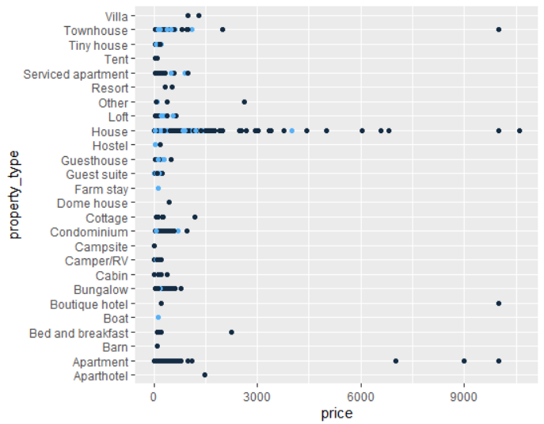
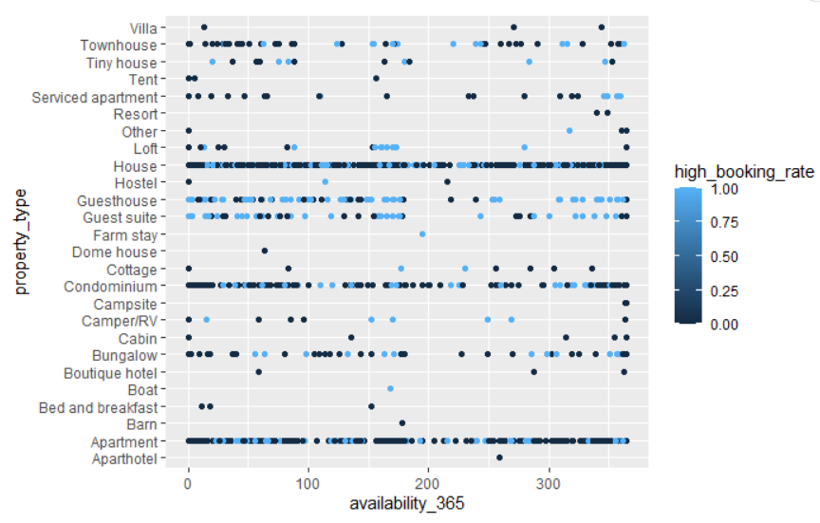
Exploratory Data Analysis of Austin Data

Slide 6
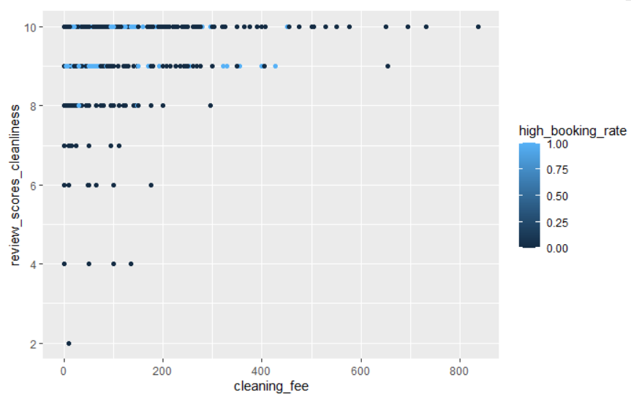
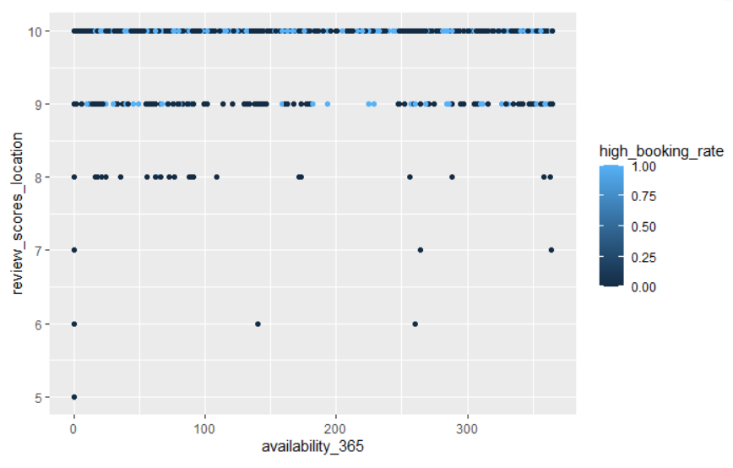
Exploratory Data Analysis(Cont.)

Slide 7
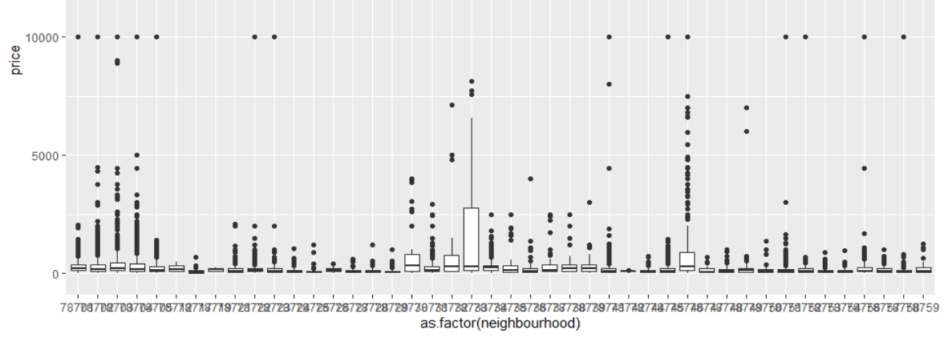
Box Plot for Neighbourhood v/s Price

Slide 8
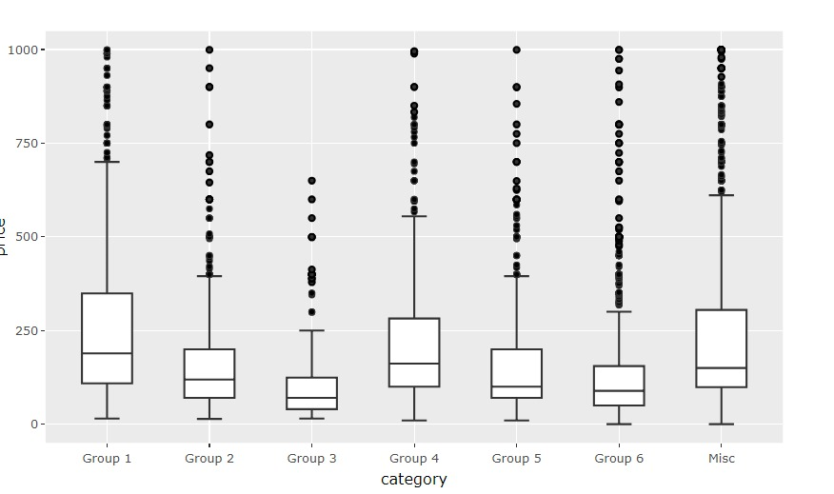
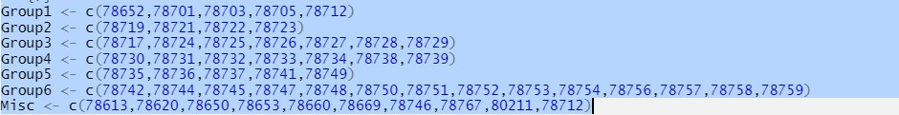
Box Plot for Prices according to different Zip Codes

Slide 9
Threshold Value for the models
We have chosen the threshold for the models as 0.35,
the main reason being that we should not miss any of the high booked property.
Also, we wouldn’t be at much loss even if we falsely predict not a high booking property as high booked property as the house will be an investment.

Slide 10
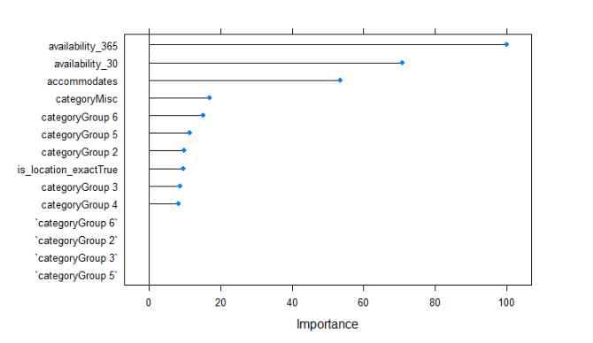
Business Case 1- Initial Acquisition
bagged trees ensemble methods
Data preprocessing: clubbed zipcodes into geographical and logical groups
Areas(zipcodes): Affordable vs luxurious
We can see that some of the area groups have really great importance
Used Available_30(for weekend getaways) and Available_365( for major event)

Slide 11
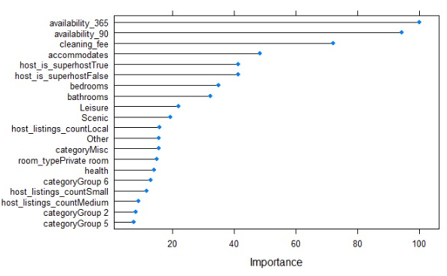
Business Case 2(1)- Pricing
Bagged tree ensemble method
Graph shows variable importance for higher prediction accuracy
Pricing most dependant on availability period, cleaning fee, accomodation, amenities and superhost or not

Slide 12
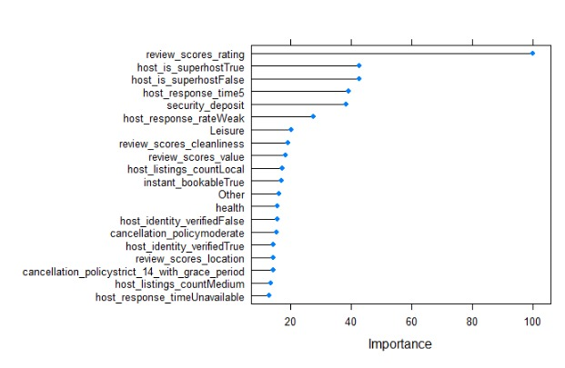
Business Case 2(2)- Management
Bagged tree ensemble method
Graph shows variable importance for higher prediction accuracy
Better review scores, host response time, host response rate help improve management
We see that professional management is not that important
.

Slide 13
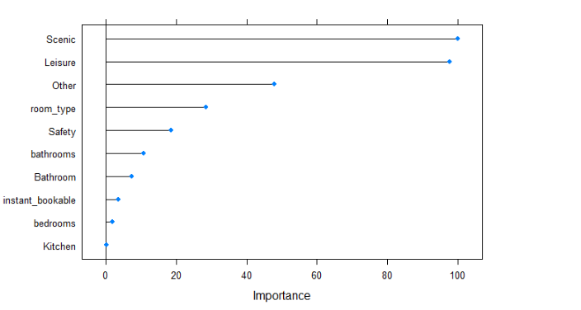
Business Case 3- Upgrades & Renovations
K Nearest Neighbors
Preprocessing: Clubbed 188 unique into 11 desired categories
People usually prefer Scenic views and leisure activities
Upgrading to these amenities can be really worthful

Slide 14
Summary for Business Cases
Business Case | Model | Accuracy | Sensitivity | Specificity
Business Case 1 | Bagged Trees | 72.77% | 56.67% | 77.79%
Business Case 2- Price | Bagged Trees | 81.34% | 78.33% | 82.27%
Business Case 2- Management | Bagged Trees | 81.45% | 78.12% | 82.34%
Business Case 3 | KNN | 72.38% | 50.21% | 79.29%
*More focus on increasing sensitivity

Slide 15
Conclusion
Austin is a great place to buy properties at cheaper rate
Along with accuracy, focus on increasing sensitivity as increased FN have more cost in this market
Every business case demands variables of different choosing for higher performance
Pricing depends on availability period, cleaning fee, accomodation, amenities and superhost or not
Management depends upon review scores, host response time, host response rate
Upgrades and Renovation depend on the property

Slide 16
Thank You!
Questions?

